Slide 1

PST 321
PRACTICAL CLASS 300 LEVEL DPT
WALKING AIDS
BY
PT MARYAM YUSUF ALI
.

Slide 2
WALKING AIDS
Walking aids are sometimes also referred to as ambulatory assistive devices.
A walking aid is one of many devices a patient may be issued in order to improve their walking pattern (gait), balance or safety while mobilizing independently.
They can also be a means of transferring weight from the upper limb to the ground, in cases where reducing weight bearing on the lower limb is desired.
Examples include crutches, canes, quadripods

Slide 3
Canes
Canes or walking sticks are designed to
Provide balance and support in standing and walking
Take some pressure of one or both legs
Improve sensory feedback for safety and security when walking
Types of canes
Three major varieties of canes are available and offer a range of support
Standard cane
Offset cane
Quadruped cane

Slide 4
Standard cane
They are generally made of aluminium
They are light weight and inexpensive
The shaft is usually straight, therefore depending on the handle force applied may not be positioned directly over the tip, which reduces stability.
Advantages
To increase balance
For pt’s with minor lower extremity weakness
For small amount of weight bearing reduction
Disadvantages
Standard canes only provide limited support

Slide 5
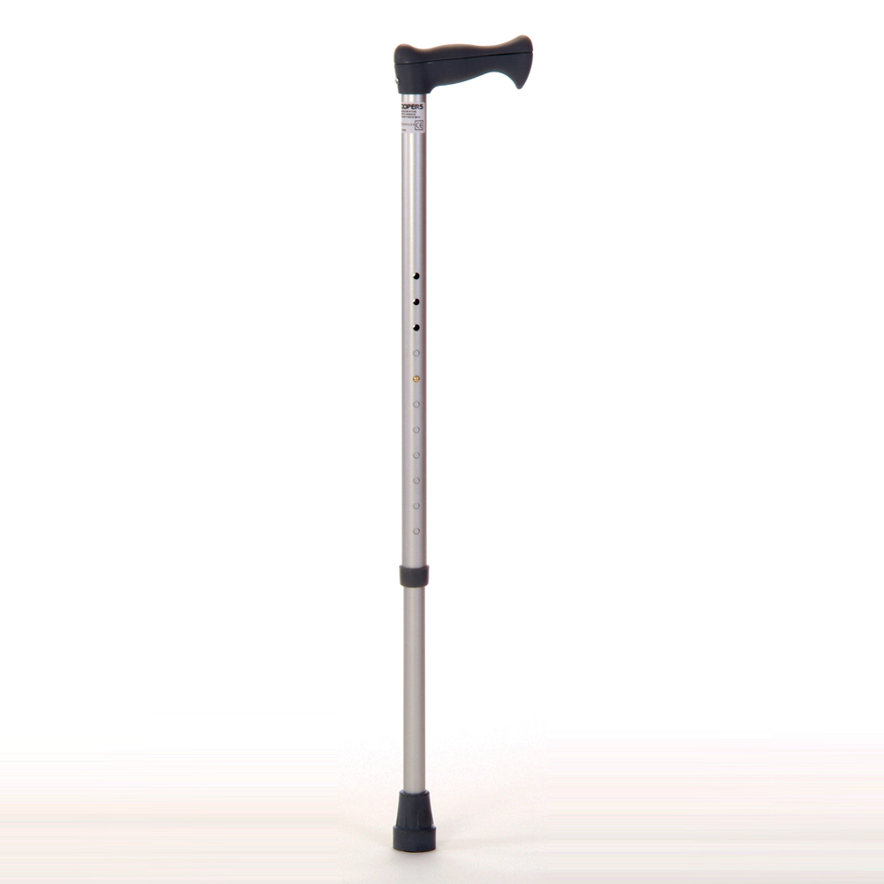

Slide 6
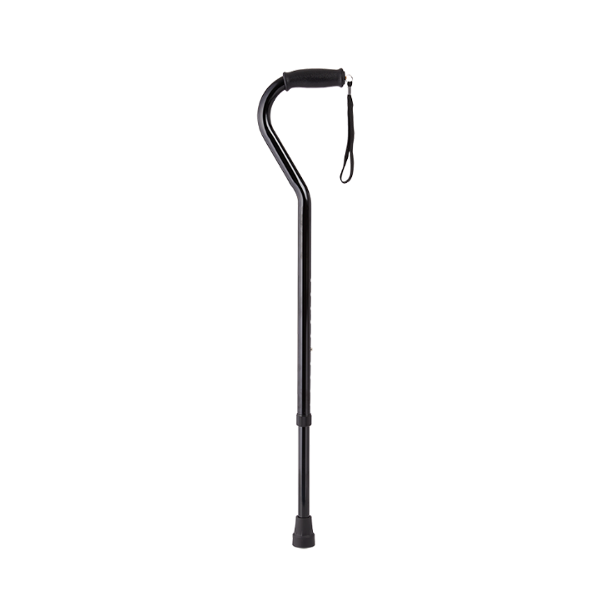
Offset Cane

Slide 7
WALK CANE
It is constructed of aluminum and aluminum tubing
It provides a broad base of support with 4 points of floor contacts
Each point is covered with a rubber tip
The legs farther from the patient’s body are angled to maintain floor contact and improve stability
It can be folded flat and the height is adjustable
Advantages
it provides a very broad-based of support
more stable
can be folded for proper storage

Slide 8
Cont.
Disadvantages
expensive
cannot be used on stairs
requires the use of a slow forward progression
pressure exerted might not be centered over the cane

Slide 9
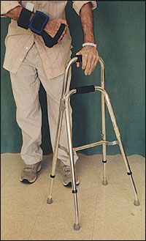

Slide 10
QUADS (QUADRUPED)
It is constructed of aluminum and aluminum tubing with a broad base of support
Each leg is covered with rubber tip
The legs closest to the patient’s body are generally shorter and may be angled to allow foot clearance
It is adjustable in height
Advantages
Adjustable
It provides a broad-based support

Slide 11
Cont.
Disadvantages
Expensive
Not practically fit for stair climbing
Pressure exerted by the hand might not be centered over the cane and might result in patient complaining of instability

Slide 12
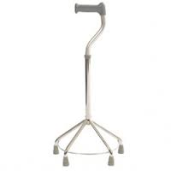
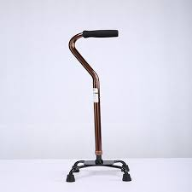

Slide 13
Measuring Canes
Place the cane approximately 6 inches from the lateral boarder of the toes
Make use of two landmarks
  Greater trochanter
  Angle of the elbow
The top of the cane should be approximately at the level of the greater trochanter
Flex the elbow to about 20⁰ to 30⁰

Slide 14
Canes Gait Pattern
Hold the cane in the upper extremity opposite the affected limb
Move the cane and the affected extremity simultaneously (level surfaces ambulation)
When both lower limbs are weak
  Look for most comfortable side
  Consider the patient balance and endurance
  Prescribe tow canes when the need for stability arises

Slide 15
CRUTCHES
Most frequently used to improve balance and relieve weight bearing (fully or partially) on lower limb(s)
They are used bilaterally to
  Increase BOS
  Improve lateral stability
  Transfer of body weight to the floor by the upper limbs

Slide 16
Types of Crutches
Axillary/Regular Crutches
Made of light wood or aluminium
Contains axillary bar, hand piece and a double uprights that are joined distally by a single leg (for height adjustment) covered with a rubber suction tip
Advantages
  Improvement of balance and lateral stability
  Provides functional ambulation with restricted weight bearing
  Easily adjustable
  Inexpensive if made of wood
  Can be used for stair climbing

Slide 17
Cont.
Disadvantages
  Its usage is awkward in small areas and crowded areas
  Leaning on the axillary bars can damage nervous and vascular structures in the axilla

Slide 18
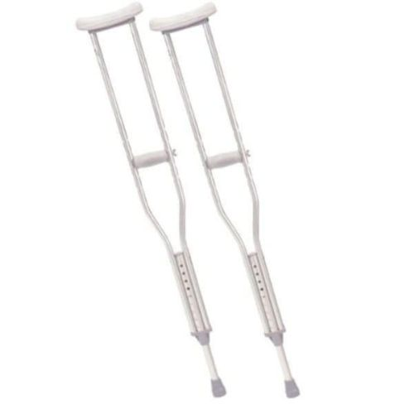

Slide 19
Measuring Crutches
Standing Position
  Put the patient in parallel bars
  Take the measurement 2 inches (using the width of 2 fingers) below the anterior axillary fold
  The distal end of the crutches should come to a point 2 inches lateral and 6 inches anterior to the foot
  Subtract 16 inches from the height of the patient to get the general estimate of the crutch height
  Adjust hand piece to provide 20⁰ to 30⁰ of elbow flexion
Supine Position
  Take the measurement from anterior axillary fold to a surface point (mat, couch or bed) 6 to 8 inches (5 -7.5cm) from the lateral boarder of the heel.

Slide 20
Forearm Crutches (Elbow crutches)
Their design include a single upright a forearm cup and handgrip.
Measurement
  Carried out in standing position in parallel bars
  Position the distal end of the crutch at a point 2 inches lateral and 6 inches anterior to the foot.
  Adjust the elbow angle to 20⁰ to 30⁰ of flexion
  Forearm cuff should be placed on the proximal third of the forearm, approximately 1 to 1.5 inches below the elbow

Slide 21
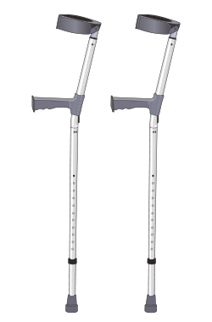

Slide 22
Gutter Crutches
An additional type of crutch which is composed of a padded forearm support made up of a metal, a strap and adjustable handpiece with a rubber ferrule.
These crutches are used for patients who are partial weight bearing.
They are particularly useful for clients with rheumatoid conditions.

Slide 23
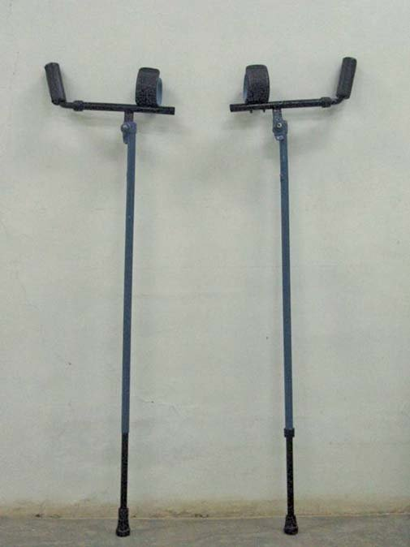

Slide 24
Important Point for the Use of Crutches
NOTE:
  Selection of a patient gait pattern is based on patient’s balance, coordination, muscle function and weight bearing.
  Gait patterns differ in their energy requirements, BOS and the speed with which they can be executed.
  During crutch walking, the body weight should be borne on the hands and not on the axillary regions
  Balance will be optimal by always maintaining wide BOS
  Hold axillary bars close to the chest while using standard crutches to provide lateral stability
  Caution the patient about the importance of holding the head up and maintaining good postural alignment during ambulation
  Turning should be accomplished by stepping in a small circle

Slide 25
Gait Patterns for the use of Crutches
Three-point gait
  There is three points of floor contact
  Usually used for non-weight bearing cases
  Body weight is borne on the crutches and the unaffected lower extremity
  Patient stands at the middle of the crutches and then places the crutches
  Then hops to the level of the crutches
Partial-weight bearing gait
  A modification of the three-point gait
  Weight is borne partially on both crutches and the affected extremity
  Emphasis on the use of a normal heel-toe progression on the affected extremity
Four-point gait
  This provides slow and stable gait
  Used with bilateral involvement of lower extremity due to poor balance, incoordination, or muscle weakness
  One crutch is advances and then opposite lower extremity is advanced

Slide 26
Cont.
Two-point gait
  Similar to four-point gait but less stable because only two points of floor contact are maintained
  It closely simulates normal gait because opposite lower and upper extremities move together.
Swing-to
  Involves forward movement of both crutches simultaneously , and the lower extremities swing to the crutches.
  Used when there is bilateral lower extremity involvement
Swing-through
  Involves forward movement of the crutches together, but the lower extremities are swung beyond the crutches
  Used when there is bilateral lower extremity involvement

Slide 27
THANK YOU FOR LISTENING

