Slide 1
NETWORKING CABLE
/ETHERNET
Mr. Peter Oladotun

Slide 2
Ethernet cables can be wired as straight-through or crossover. The straight-through is the most common type and is used to connect computers to hubs or switches.

Slide 3
What Is Straight-Through Cable?
A straight-through cable is a type of twisted pair Ethernet cable used in local area networks (LANs) to connect different types of devices, such as a computer to a switch or router.
On a straight-through cable, both ends follow the same wiring standard — either T568A or T568B. That means the wire colors on both ends match exactly.

Slide 4
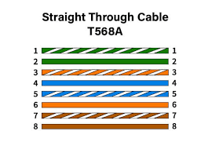

Slide 5
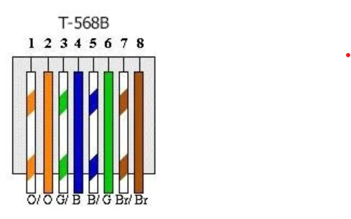

Slide 6
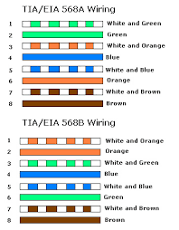

Slide 7
Typical Uses of Straight-Through Cable:
Connect a computer to a switch or hub's normal port.
Connect a computer to a cable/DSL modem's LAN port.
Connect a router's WAN port to a modem's LAN port.
Connect a router's LAN port to a switch/hub's uplink port (for expanding network).
Connect two switches/hubs with one uplink port and one normal port.

Slide 8
Crossover cables are less common and mainly used to connect similar devices directly, such as one computer to another.

Slide 9
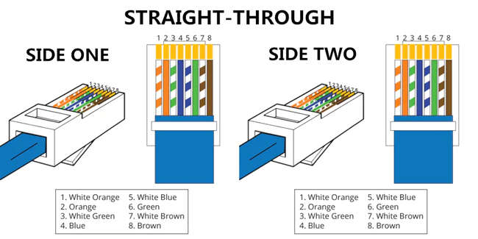

Slide 10
Network Devices
Mr. Peter Oladotun

Slide 11

Have you ever dreamed of creating your own app, game, or website? What would it do?
What if you could write a program to automate a task you hate doing? What would you automate?

Slide 12



Switches
Switch

Slide 13
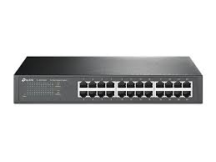
SWITCH
A switch is a network device that connects multiple devices within a single network, typically a Local Area Network (LAN). It operates at Layer 2 (Data Link Layer) of the OSI model.

Slide 14
SWITCH
Function:
Its primary function is to forward data packets (also called frames) to their correct destination device. Unlike a simple hub, which broadcasts data to all connected devices, a switch intelligently learns the MAC address of each device on its ports and only sends the data to the intended recipient. This reduces network traffic and improves efficiency.

Slide 15
SWITCH
Operation: When a data frame enters a switch, it reads the destination MAC address. It then looks up this address in its internal table (MAC address table) to find the port associated with that address. If it finds a match, it forwards the frame out of that specific port. If the address isn't in its table, it broadcasts the frame to all ports, learns the MAC address of the reply, and updates its table for future use.

Slide 16
SWITCH
Use: Switches are used to build the internal structure of most wired networks, connecting computers, printers, servers, and other switches to create a seamless local network.

Slide 17
SWITCH
Switches are critical network devices operating at the Data Link Layer (Layer 2 of the OSI model), responsible for forwarding data frames within a local area network (LAN) based on MAC addresses. They come in two primary types: unmanaged and managed switches, each designed for different use cases, offering distinct levels of control, functionality, and complexity. Below is a detailed exploration of these switch types, their features, use cases, advantages, and disadvantages.

Slide 18
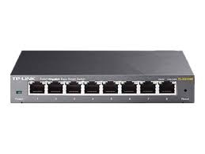
Switches
UNMANAGED SWITCH
MANAGED SWITCH

Slide 19
UNMANAGED SWITCH
Unmanaged switches are basic, plug-and-play devices that require no configuration. They are designed to automatically handle data forwarding within a network, making them simple to deploy and use.

Slide 20
Key Characteristics
Plug-and-Play Operation: No user intervention is needed; the switch automatically learns MAC addresses and forwards frames.
Fixed Configuration: Preconfigured settings for speed, duplex mode, and other parameters, which cannot be modified.
Basic Functionality: Supports fundamental switching tasks, such as frame forwarding and collision domain separation.
No Management Interface: Lacks a web interface, command-line interface (CLI), or software for configuration.
Cost-Effective: Generally, less expensive due to simplicity and limited features.

Slide 21
How They Work
MAC Address Learning: When a device sends a frame, the switch records its MAC address and associated port in a MAC address table.
Frame Forwarding: Frames are sent only to the destination port (based on the MAC address), reducing unnecessary traffic.
Broadcast and Unknown Unicast: If the destination MAC address is unknown or a broadcast, the frame is sent to all ports except the source.

Slide 22
How They Work
MAC Address Learning: When a device sends a frame, the switch records its MAC address and associated port in a MAC address table.
Frame Forwarding: Frames are sent only to the destination port (based on the MAC address), reducing unnecessary traffic.
Broadcast and Unknown Unicast: If the destination MAC address is unknown or a broadcast, the frame is sent to all ports except the source.

Slide 23
Advantages
Ease of Use: Requires no technical expertise; ideal for non-technical users.
Quick Deployment: Simply connect devices, and the switch starts working immediately.
Low Cost: Affordable for small networks or budget-conscious setups.
Low Maintenance: No need for ongoing configuration or monitoring.
Reliability: Fewer features mean fewer points of failure in basic operations.

Slide 24
Disadvantages
Limited Control: Users cannot customize settings like VLANs, QoS, or port prioritization.
No Monitoring: Lacks tools to track network performance or troubleshoot issues.
Scalability Issues: Not suitable for complex or growing networks requiring advanced features.
Security Limitations: No support for features like port security or access control lists (ACLs).

Slide 25
Use Cases
Home Networks: Connecting computers, gaming consoles, and smart TVs in a household.
Small Offices: Basic LAN setups with minimal devices and no need for advanced management.
Temporary Networks: Event-based or short-term setups where simplicity is prioritized.

Slide 26
MANAGED SWITCH
Managed switches offer advanced configuration options, allowing network administrators to customize and control network behavior. They provide features like VLANs, Quality of Service (QoS), and security settings, making them suitable for complex networks.

Slide 27
Key Characteristics
Configurable Settings: Support for VLANs, QoS, link aggregation, and more via a management interface (web, CLI, or SNMP).
Advanced Features:
  VLANs: Segment networks for improved security and performance.
  QoS: Prioritize traffic (e.g., VoIP or video streaming) for better performance.
  Port Mirroring: Monitor traffic for troubleshooting.
Spanning Tree Protocol (STP): Prevents network loops in redundant setups

Slide 28
Key Characteristics
Management Interfaces:
  Web-based GUI for user-friendly configuration.
  CLI for advanced scripting and automation.
SNMP (Simple Network Management Protocol) for remote monitoring

Slide 29
Key Characteristics
Higher Cost: More expensive due to advanced hardware and software capabilities.
Types of Managed Switches:
  Fully Managed: Full control over all features, used in enterprise settings.
  Smart Switches: Partial management features, a middle ground between unmanaged and fully managed.

Slide 30
How They Work
Customizable Frame Forwarding: Administrators can define rules for frame handling (e.g., VLAN tagging, traffic prioritization).
Dynamic Management: Updates to the MAC address table or routing policies can be manually adjusted.
Monitoring and Diagnostics: Provide real-time data on traffic, errors, and port status.
Security Features: Support port security, MAC filtering, and 802.1X authentication.

Slide 31
Advantages
Flexibility: Customizable to meet specific network requirements (e.g., VLANs for department segmentation).
Scalability: Suitable for growing networks with complex needs.
Enhanced Security: Features like ACLs and port security protect against unauthorized access.

Slide 32
Advantages
Traffic Optimization: QoS ensures critical applications (e.g., VoIP) receive priority.
Monitoring and Troubleshooting: Detailed insights into network performance via SNMP or port mirroring.
Redundancy Support: STP and link aggregation improve reliability.

Slide 33
Disadvantages
Higher Cost: More expensive than unmanaged switches due to advanced features.
Complexity: Requires technical expertise for setup and management.
Maintenance Overhead: Ongoing configuration and monitoring may be needed.
Power Consumption: Typically consumes more power due to advanced processing.

Slide 34
Use Cases
Enterprise Networks: Large organizations requiring VLANs for department separation and QoS for critical applications.
Data Centers: High-performance switching with redundancy and monitoring.
Educational Institutions: Campus networks with multiple VLANs for students, faculty, and administration.
VoIP and Video Networks: Prioritizing voice and video traffic for seamless performance.

Slide 35
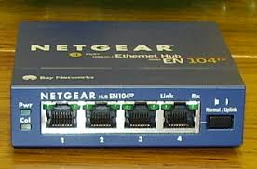
HUB
A hub is a basic networking device that connects multiple devices in a local area network (LAN), enabling them to communicate by broadcasting data to all connected devices. Operating at the Physical layer of the OSI model, hubs are simple, legacy devices that have largely been replaced by more advanced devices like switches in modern networks. connectivity.

Slide 36
HUB
A hub is a network device that connects multiple devices (e.g., computers, printers) in a LAN, acting as a central point for data transmission.
It receives data from one device and broadcasts it to all other connected devices, regardless of the intended recipient.
Hubs are simple, unintelligent devices that operate at the Physical layer (Layer 1) of the OSI model, dealing solely with electrical or optical signals.

Slide 37
HUB
Key Role: Facilitates basic connectivity by relaying signals to all ports, enabling devices to share a network.
Common Use Cases: Small LANs in homes, small offices, or educational settings (primarily in the 1990s–early 2000s).

Slide 38
HUB
Key Role: Facilitates basic connectivity by relaying signals to all ports, enabling devices to share a network.
Common Use Cases: Small LANs in homes, small offices, or educational settings (primarily in the 1990s–early 2000s).

Slide 39
Router
A router is a networking device that connects multiple networks together and directs (routes) data packets between them.

Slide 40
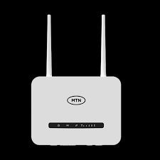

Router

Slide 41
Function
It decides the best path for data to travel from the source to the destination across different networks (e.g., from your home network to the Internet).

Slide 42
Key Roles:
Connects LAN (Local Area Network) to WAN (Wide Area Network)
Assigns IP addresses via DHCP
Routes data packets efficiently
Provides basic firewall protection

Slide 43
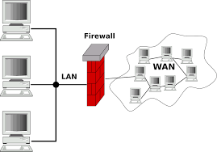
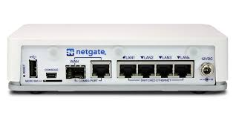
Key Roles:

Slide 44
FIREWALL
A firewall is a network security device or software that monitors and controls incoming and outgoing network traffic based on predetermined security rules.
Function:
It acts as a barrier between a trusted internal network and an untrusted external network (such as the Internet).

Slide 45
FIREWELL
Types:
Hardware Firewall: Physical device installed between the network and the Internet.
Software Firewall: Installed on individual computers.
Key Roles:
Blocks unauthorized access
Filters malicious traffic
Protects against cyber threats
Example:
The Windows Defender Firewall on your PC or a Cisco ASA firewall device in organizations.

Slide 46

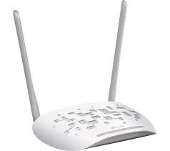
Access Point (AP)

Slide 47
Access Point (AP)
An Access Point is a networking device that allows wireless devices to connect to a wired network using Wi-Fi.
Function:
It acts as a central transmitter and receiver of wireless radio signals.
Key Roles:
  Extends wireless coverage
  Connects Wi-Fi-enabled devices (laptops, phones) to the network
  Supports multiple devices at once
Example:
The wireless access point in your office that provides Wi-Fi connectivity.

Slide 48
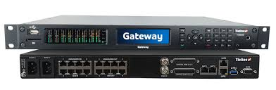
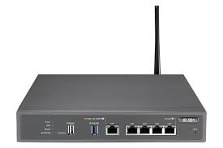
Gateway

Slide 49
Gateway
A gateway is a device or software that acts as a bridge between different networks using different protocols.
Function:
It translates data from one network format to another (for example, between a private LAN and the Internet).

Slide 50
Gateway
Key Roles
Connects networks with different architectures
Translates communication protocols
Serves as an entry/exit point for network traffic
Example
Your home router also serves as a default gateway, allowing your computer to communicate with external websites.

Slide 51
Gateway
A MODEM (short for Modulator-Demodulator) is a networking device that allows digital data from a computer to be transmitted over analog communication lines, such as telephone lines or cable systems.
Full Meaning:
MOdulator–DEModulator
Main Function:
A modem converts (modulates) digital signals from a computer into analog signals that can travel over telephone or cable lines, and then converts (demodulates) incoming analog signals back into digital form for the computer to understand.

Slide 52
OSI MODELS
Mr. Peter Oladotun

Slide 53
Question
Have you ever wondered how your phone sends a photo to your friend’s phone across the world? What steps do you think the internet takes to make that happen?

Slide 54
Open Systems Interconnection (OSI)
The Open Systems Interconnection (OSI) Reference Model, developed by the International Organization for Standardization (ISO) in 1984, is a conceptual framework that standardizes the functions of a communication system into seven distinct layers.
It provides a universal blueprint for understanding, designing, and troubleshooting network architectures.
Each layer performs specific tasks and interacts with the layers above and below it, ensuring seamless end-to-end communication..

Slide 55
Open Systems Interconnection (OSI)
The OSI (Open Systems Interconnection) Model is a conceptual framework used to understand how different networking protocols interact in a computer network.

Slide 56
Open Systems Interconnection (OSI)
The OSI model explains how data travels from one computer to another.
It breaks the process into 7 simple steps (layers) or
It divides network communication into seven layers, each with distinct responsibilities

Slide 57
Open Systems Interconnection (OSI)
Understand the purpose and structure of the OSI model.
Learn the functions and responsibilities of each of the seven layers.
Identify real-world examples of protocols and technologies for each layer.
Comprehend how data flows through the layers via encapsulation.
Recognize the OSI model’s role in network design and troubleshooting.

Slide 58
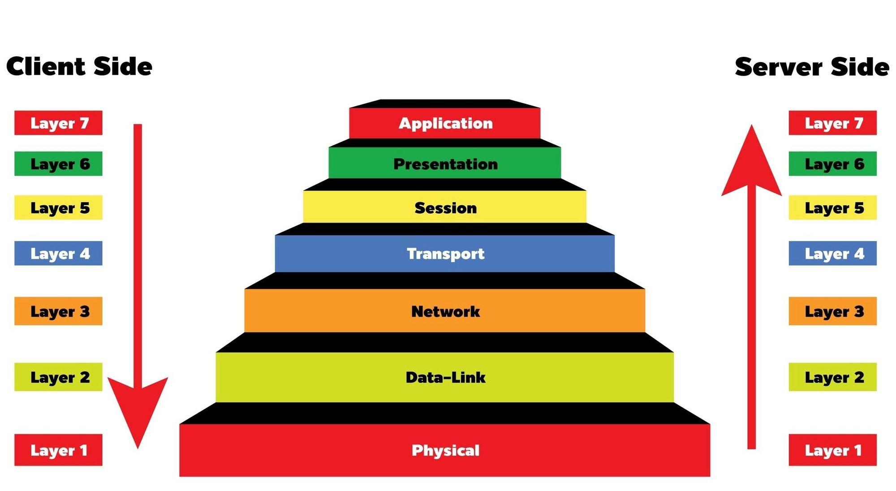
Open Systems Interconnection (OSI)

Slide 59
Acronym
“All People Seem To Need Data Processing”
1. A → Application
2. P → Presentation
3. S → Session
4. T → Transport
5. N → Network
6. D → Data Link
7. P → Physical

Slide 60
Bottom to Top Version
If you prefer to remember Physical → Application:
“Please Do Not Throw Sausage Pizza Away”
1. P → Physical
2. D → Data Link
3. N → Network
4. T → Transport
5. S → Session
6. P → Presentation
7. A → Application

Slide 61
Open Systems Interconnection (OSI)
1. Physical Layer (Layer 1)
Function: Responsible for the transmission and reception of raw bits (0s and 1s) over a physical medium, such as cables, fiber optics, or wireless signals.

Slide 62
Open Systems Interconnection (OSI)
Key Responsibilities:
  Defines physical characteristics: cables, connectors, voltages, and signal timing.
  Handles bit-level transmission (e.g., electrical or optical signals).
  Specifies network topology (e.g., bus, star, ring).
  Manages modulation (e.g., converting digital bits to analog signals for modems).

Slide 63
Open Systems Interconnection (OSI)
Examples:
Cables: Ethernet (Cat5e, Cat6), fiber optics (SMF, MMF).
Connectors: RJ45, USB, SC/LC (fiber).
Wireless: Wi-Fi radio signals (IEEE 802.11), Bluetooth.
Devices: Hubs, repeaters, physical ports of modems.
Standards: RS-232, V.35, 10Base

Slide 64
Open Systems Interconnection (OSI)
2. Data Link Layer (Layer 2)
Function: Ensures reliable data transfer between two directly connected nodes, handling error detection and correction, and managing access to the physical medium. It Prepares data for the physical network and It Uses MAC addresses.

Slide 65
Key Responsibilities:
  Frames data by adding headers and trailers (e.g., Ethernet frames).
  Performs error detection (e.g., Cyclic Redundancy Check - CRC).
  Manages flow control to prevent overwhelming the receiver.
  Uses Media Access Control (MAC) addresses for device identification.
  Handles access methods (e.g., CSMA/CD for Ethernet, CSMA/CA for Wi-Fi).

Slide 66
Examples:
  Protocols: Ethernet (IEEE 802.3), Point-to-Point Protocol (PPP), HDLC.
  Technologies: Wi-Fi (IEEE 802.11), VLANs, Frame Relay.
  Devices: Switches, bridges, Network Interface Cards (NICs).
  Example: MAC address (e.g., 00: 1A:2B: 3C:4D:5E).

Slide 67
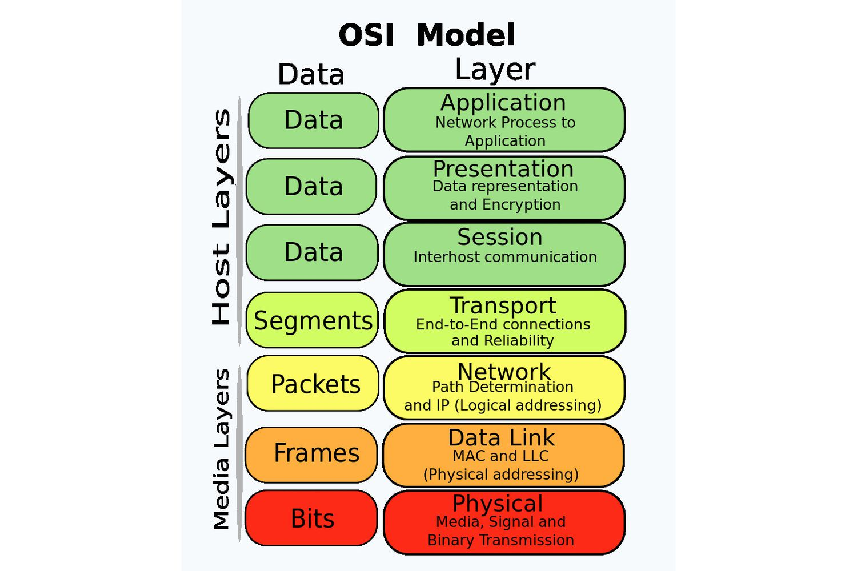

Slide 68
Network Layer (Layer 3)
Function: Manages logical addressing and routing of data packets across multiple networks to reach the intended destination.

Slide 69
Key Responsibilities:
  Assigns logical addresses (e.g., IP addresses).
  Determines optimal paths for data (routing).
  Handles packet forwarding, fragmentation, and reassembly.
  Supports inter-network communication.

Slide 70
Examples:
  Protocols: Internet Protocol (IP - IPv4, IPv6), ICMP, IPsec.
  Devices: Routers, Layer 3 switches.
  Routing Protocols: OSPF, BGP, RIP.
  Example: IP address (e.g., 192.168.1.1).

Slide 71
4. Transport Layer (Layer 4)
Function: Provides reliable or unreliable end-to-end data transfer between hosts, ensuring data arrives complete, in order, or quickly as needed.

Slide 72
Key Responsibilities:
  Segments and reassembles data for transmission.
  Manages flow control (e.g., TCP windowing).
  Performs error detection and retransmission (for reliable protocols).
  Supports connection-oriented (e.g., TCP) or connectionless (e.g., UDP) communication.
  Uses port numbers to identify applications.

Slide 73
Examples:
  Protocols: Transmission Control Protocol (TCP), User Datagram Protocol (UDP).
  Port Numbers: 80 (HTTP), 443 (HTTPS), 53 (DNS).
  Technologies: TCP three-way handshake, UDP for streaming.

Slide 74
MORE EXPLANATION ON TCP AND UDP
TCP – “Talk Carefully Protocol”
Think of TCP like a phone call.
When you call someone:
You confirm they picked the call (connection)
You speak slowly and clearly
If the person didn’t hear you, you repeat (retransmission)
Both of you take turns talking (order is maintained)

Slide 75
TCP Characteristics:
Connection-oriented (handshake before sending data)
Reliable (no missing data)
Data arrives in order
Slower (because of checks and confirmations)
Used where accuracy is important.

Slide 76
Examples of where TCP is used:
Web browsing (HTTP/HTTPS)
Email (SMTP)
File transfer (FTP)
Banking apps

Slide 77
Feature | TCP | UDP
Connection | Yes (Handshakes) | No
Speed | Slow | Fast
Reliability | High | Low
Ordered Delivery | Yes | No
Data Loss | No | Yes (possible)
Best For | Web, Email, Files | Games, Calls, Live stream

Slide 78
5. Session Layer (Layer 5)
Function: Establishes, manages, and terminates communication sessions between applications on different devices.
Key Responsibilities:
  Sets up and maintains sessions (e.g., login sessions).
  Synchronizes data exchange (e.g., checkpoints for recovery).
  Controls dialogue modes (e.g., full-duplex, half-duplex).

Slide 79
  Protocols: NetBIOS, Remote Procedure Call (RPC), Server Message Block (SMB).
  Technologies: Session Initiation Protocol (SIP) for VoIP, session management in web applications.
  Example: Maintaining a user’s session during an online banking transaction.

Slide 80
6. Presentation Layer (Layer 6)
Function: Translates data between the application layer and lower layers, ensuring it’s in a usable format. Handles encryption, compression, and data formatting.
Key Responsibilities:
  Converts data formats (e.g., ASCII to EBCDIC).
  Encrypts and decrypts data (e.g., for secure communication).
  Compresses data to reduce transmission size.
  Manages character encoding and file formats.

Slide 81
Examples:
  Protocols: SSL/TLS, MIME (Multipurpose Internet Mail Extensions).
  Formats: JPEG, PNG, GIF, XML, JSON.
  Example: Encrypting data for HTTPS or compressing video for streaming.

Slide 82
7. Application Layer (Layer 7)
Function: Provides network services directly to end-user applications, enabling user interaction with the network.
Key Responsibilities:
  Supports application-specific protocols for user services.
  Enables resource sharing, remote access, and network-based applications.
  Provides user interfaces for network communication.

Slide 83
Examples:
  Protocols: HTTP/HTTPS, File Transfer Protocol (FTP), Simple Mail Transfer Protocol (SMTP), Domain Name System (DNS).
  Applications: Web browsers (Chrome, Firefox), email clients (Outlook), FTP clients.
  Example: Accessing a website via HTTP or sending an email via SMTP.

Slide 84
INTRODUCTION TO TCP/IP PORTS
Mr. Peter Oladotun

Slide 85
In computer networking, a port is a communication endpoint.
Just like a house has many doors for different purposes, a computer uses ports to allow multiple network services to run at the same time without confusion.

Slide 86
A port is a number between 0 and 65,535 used to identify specific applications or services running on a device.
Ports work with IP addresses to ensure data reaches the correct application.
IP Address = the house address
Port = the door inside the house

Slide 87
192.168.1.20:80
IP Address Port Number

Slide 88
Why Ports Are Needed
Ports help the operating system do the following:
Separate multiple network services
Your computer can access:
Web browser → port 80/443
Email → port 25/110/143
Remote desktop → port 3389
all at the same time without confusion.

Slide 89
Identify which application should receive data
If a web page is requested:
OS forwards traffic to port 80 or 443
If an email is received:
OS forwards traffic to port 25 or 110

Slide 90
Categories of Port Numbers
Port numbers are grouped into three categories:
Category | Port Range | Description
Well-Known Ports | 0–1023 | Assigned to standard, popular services
Registered Ports | 1024–49151 | Assigned to specific applications
Dynamic/Private Ports | 49152–65535 | Used temporarily by apps (ephemeral ports)

Slide 91
Common Well-Known TCP/IP Ports and Their Functions
Web and Internet Services
Port | Protocol | Purpose
80 | HTTP | Unsecured web browsing
443 | HTTPS | Secure/encrypted web browsing

Slide 92
File Transfer and Remote Access
Port | Protocol | Purpose
20/21 | FTP | File transfer
22 | SSH | Secure remote command access
23 | Telnet | Unsecured remote access
69 | TFTP | Simple file transfer (UDP)

Slide 93
Networking & Security Services
Port | Protocol | Purpose
53 | DNS | Converts domain names to IP addresses
67/68 | DHCP | Assigns IP addresses automatically
161 | SNMP | Network monitoring and management

Slide 94
Windows Services
Port | Protocol | Purpose
135 | RPC | Remote procedure calls
139 | NetBIOS | File/printer sharing
445 | SMB | Windows file sharing
3389 | RDP | Remote Desktop Protocol

Slide 95
Database Services
Port | Protocol | Purpose
1433 | MSSQL | Microsoft SQL Server
3306 | MySQL | MySQL Database
1521 | Oracle | Oracle Database

Slide 96
MCQ Question
1. A web application is inaccessible but server is running. Which command helps confirm port is open?
Notes:
Answer: B. telnet server_ip 80

Slide 97
MCQ Question
2. MySQL server unreachable after config change. Which port?
Notes:
Answer: B. 3306

Slide 98
MCQ Question
3. Secure API failing. HTTPS likely blocked on which port?
Notes:
Answer: B. 443

Slide 99
MCQ Question
4. Remote desktop failing. Check which port?
Notes:
Answer: B. 3389

Slide 100
MCQ Question
5. Mail server receives mail but cannot send. Which port is blocked?
Notes:
Answer: C. 25

Slide 101
MCQ Question
6. DNS query failing. Which port affected?
Notes:
Answer: B. 53

Slide 102
MCQ Question
7. Web server uses port 8080. Which URL format?
Notes:
Answer: A. http://server_ip:8080

Slide 103
MCQ Question
8. Attacker tries accessing router via port 23. Best action?
Notes:
Answer: C. Block 23 & enable SSH on 22

Slide 104
MCQ Question
10. Microservices use port 5000, communication fails after patch. Likely issue?
Notes:
Answer: B. Internal firewall blocked port 5000

Slide 105
THANK YOU SO MUCH FOR YOUR KIND ATTENTION

