Slide 1
How to Add a School Email to Your Device Using the Gmail App
Mr. Peter Oladotun

Slide 2
What is a School Email?
A school email is an official email account provided by your institution for academic communication, learning resources, and access to educational services.

Slide 3
Before You Begin
School email address
Password for the email account
Gmail App installed
Active internet connection

Slide 4
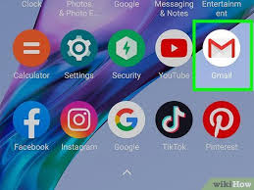
Step 1: Open the Gmail App
1. Open the Gmail App on your phone or tablet.
2. Ensure you are connected to the internet.

Slide 5
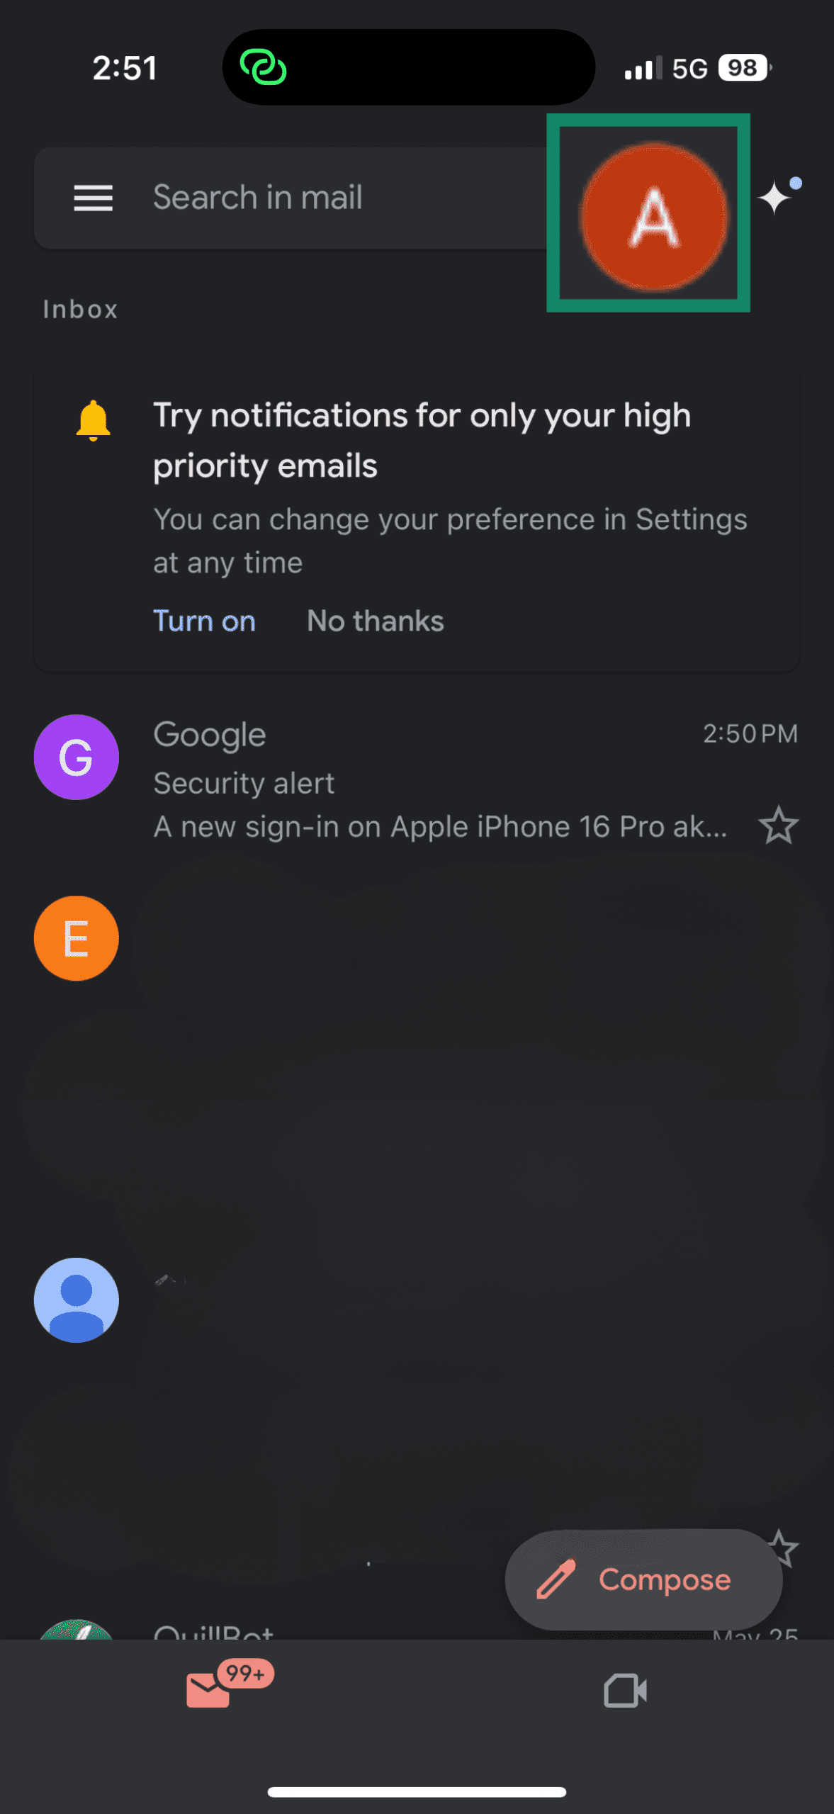
Step 2: Access Account Settings
1. Tap your profile picture in the top-right corner.
2. Select 'Add another account'.

Slide 6
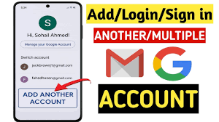
Step 2: Access Account Settings
2. Select 'Add another account'.

Slide 7
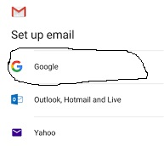
Step 3: Choose the Email Provider
Select the type of school email:
• Google

Slide 8
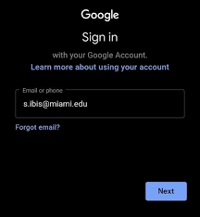
Step 4: Enter Your School Email
1. Type your school email address.
2. Tap Next.
Example: ahmed.fa @ student.newgateuniversityminna.edu.ng

Slide 9
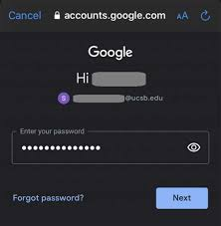
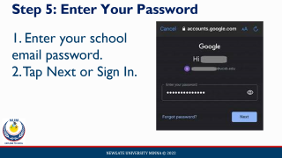
Step 5: Enter Your Password
1. Enter your school email password.
2. Tap Next or Sign In.

Slide 10
Step 6: Complete Verification
1. Follow any additional instructions.
2. Approve two-factor authentication if required.
3. Accept terms and conditions.

Slide 11
Step 7: Account Successfully Added
Your school email will appear in Gmail. You can send/receive emails and switch between accounts.

Slide 12
Step 7: Account Successfully Added
Your school email will appear in Gmail. You can send/receive emails and switch between accounts.

Slide 13
Switching Between Accounts
1. Tap your profile picture.
2. Select the account you want to use.
3. Gmail switches to that mailbox.
.

Slide 14
Common Problems and Solutions
Wrong password – Re-enter correctly
Cannot sign in – Check internet
Verification failure – Contact ICT Support
Email not syncing – Refresh Gmail

Slide 15
Benefits of Using School Email
Receive official announcements
Communicate with lecturers
Access educational resources
Participate in online classes

Slide 16
Conclusion
Open Gmail → Add another account → Enter school email and password → Complete verification.

Slide 17
QUESTONS AND ANSWERS

Slide 18
QUESTION 1
Answer: B
1. What is a school email?
A. A personal email account
B. An official email provided by an institution
C. A social media account
D. A gaming account

Slide 19
QUESTION 2
Answer: C
Which icon should you tap to add another account in Gmail?
A. Search icon
B. Settings icon
C. Profile picture
D. Refresh icon

Slide 20
QUESTION 3
Answer: B
After tapping the profile picture, which option should you select?
A. Delete Account
B. Add another account
C. Create Folder
D. Archive Mail

Slide 21
QUESTION 4
Answer: A,B,C,D
Which of the following are required before adding a school email?
A. School email address
B. Password
C. Internet connection
D. Gmail App

Slide 22
QUESTION 4
Answer: A,B,C,D
Possible solutions when email is not working include:
A. Check internet connection
B. Verify password
C. Refresh Gmail
D. Contact ICT Support

Slide 23
QUESTION 4
What option should you select after tapping your profile picture in Gmail to add a school email?
Answer: Add another account.

Slide 24
NEWGATE UNIVERSITY MINNA eLEARNING (NUeL)
STUDENT GUIDE TO LOGIN AND PASSWORD RESET
Mr. Peter Oladotun

Slide 25
Objectives
• Access the NUeL platform
• Log in successfully
• Navigate the dashboard
• Access registered courses
• Reset forgotten passwords
• Secure accounts

Slide 26
What is NUeL?
NUeL is the University's online learning system for accessing lecture materials, assignments, virtual classes, quizzes, discussions and course resources.

Slide 27
Requirements for Login
• Internet Connection
• Smartphone, Tablet, Laptop, or Desktop
• Matric Number
• Password
• Active University Email

Slide 28
Step 1 Open the Platform
Open your browser and visit:
elearning.newgateuniversityminna.edu.ng

Slide 29
Step 2 Click Login
Locate and click the Log In button on the homepage at the top right corner

Slide 30
Step 3 Enter Login Details
Enter your Username and Password, then click Log In.
Username like : 26a-ue-bns-0419

Slide 31
Successful Login
Access your dashboard to view courses, assignments, quizzes and announcements.

Slide 32
Accessing Your Courses
1. Click My Courses
2. Select a Course
3. Open Learning Materials
4. Download Resources

Slide 33
Forgotten Password?
Click Lost password on the login page.
It is below the login button

Slide 34
Password Reset Step 2
Enter your Username or University Email Address.
Please note: Its only one of these two, you will use.

Slide 35
Password Reset Step 3
A password reset email will be sent if your account is found.

Slide 36
Important Notice
The password reset link will be sent to your OFFICIAL UNIVERSITY EMAIL ADDRESS.
Check Inbox, Spam and Junk folders.

Slide 37
Password Reset Step 4
Open the email and click the Password Reset Link.

Slide 38
Password Reset Step 5
Create a strong password using letters, numbers and symbols.
Always use the password you can remember.

Slide 39
Password Reset Completed
Return to the portal and log in using your new password.

Slide 40
Security Best Practices
• Never share passwords
• Log out after use
• Use strong passwords
• Secure your email

Slide 41
Troubleshooting
Verify username, password, internet connection and email inbox.

Slide 42
Contact Support
Email: elearning@newgateuniversityminna.edu.ng
Or
supportict@ newgateuniversityminna.edu.ng

Slide 43
Thank You
NEWGATE UNIVERSITY MINNA
Questions & Answers

